Slide 1



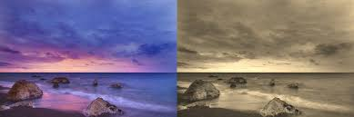
Session 11 :
Introduction to Applying Filters

Slide 2

Introduction
Applying Filters for Artistic Effects
Add creative visual flair to images using OpenCV

Slide 3
Learning Outcome
- Create fun image filters like cartoon and pencil sketch effects.
- Gain hands-on experience with OpenCV's filtering and edge detection tools.
- Understand creative image processing fundamentals.

Slide 4
Python Programming Task : Artistic Effects
Write a Python script using OpenCV to:
- Convert a photo into a cartoon-style image.
- Generate a pencil sketch version of the input image.
- Use functions like cv2.bilateralFilter, cv2.Canny, and cv2.pencilSketch.

Slide 5
Why It Matters
- Artistic filters enhance visual appeal and user engagement.
- Widely used in apps like Instagram, Snapchat, and PicsArt.
- Supports features like stylized selfies, AR masks, and fun effects.

Slide 6
Real-World Applications
- Instagram Filters: Add cartoon/smooth edges to selfies.
- Snapchat Lenses: Real-time sketch filters with face detection.
- Photo Editors: Let users transform photos into hand-drawn styles.

Slide 7
Creating Artistic Effects
- Use edge detection, color quantization, and bilateral filtering.
- Techniques simulate artistic drawings.
- Mimic cartoon or sketch appearances with minimal code.

Slide 8
Cartoon Effect Pipeline
1. Apply bilateral filter for color smoothing.
2. Use Canny edge detection for outlining.
3. Combine edges with the smoothed image.
Code:
edges = cv2.Canny(gray, 100, 200)
cartoon = cv2.bitwise_and(color_filtered, color_filtered, mask=edges)

Slide 9
Pencil Sketch Techniques
- Use OpenCV's cv2.pencilSketch() for a fast result.
- Or apply grayscale inversion + Gaussian blur method.
Code:
gray = cv2.cvtColor(img, cv2.COLOR_BGR2GRAY)
inv = 255 - gray
blur = cv2.GaussianBlur(inv, (21, 21), 0)
sketch = cv2.divide(gray, 255 - blur, scale=256)

Slide 10
Tuning for Better Results
- Adjust:
- Bilateral filter diameter.
- Edge detection thresholds.
- Sketch blur intensity.
- Every image needs different settings for best results.

Slide 11
Comparing Visual Transformations
- Use Matplotlib to show original vs. filtered image.
- Helps in debugging and selecting the best filter strength.
Code:
plt.subplot(1, 2, 1), plt.imshow(original)
plt.subplot(1, 2, 2), plt.imshow(filtered)

Slide 12
Python Code :
Applying Filters for Artistic Effects
Project Title: Custom Artistic Filters with Parameter Tuning
Objective: Create cartoon and sketch effects with adjustable filter parameters

Slide 13
Step 1 – Image Loading & Trackbar Setup
Image Loading: Load with cv2.imread and validate input
Trackbar Setup:
- Diameter (5-15)
- Sigma Color (10-150)
- Edge Threshold (1-10)
- Mode Selection: Cartoon (0) or Sketch (1)

Slide 14
Step 2 – Cartoon Effect Implementation
Smoothing: Apply cv2.bilateralFilter using trackbar parameters
Edge Detection:
- Convert to grayscale
- Use cv2.adaptiveThreshold with edge constant
- Invert mask for edges
Cartoon Effect: Combine smoothed image and mask with cv2.bitwise_and

Slide 15
Step 3 – Sketch Effect & Toggle
Sketch Effect: Use cv2.pencilSketch with default parameters
Mode Toggle: Use trackbar (0 = Cartoon, 1 = Sketch)
Allows dynamic switching between effects

Slide 16
Real-Time Display & Exit Strategy
Display updated effects in real-time using cv2.imshow
Trackbar inputs adjust output live
Exit the loop on pressing 'q'
Ensure proper cleanup with cv2.destroyAllWindows

Slide 17

Python Script on Applying Filters
PART 1
import cv2
import numpy as np
def nothing(x):
pass
image = cv2.imread('image.jpg')
if image is None:
raise ValueError("Image not found!")

Slide 18
Python Script on Applying Filters
PART 2
cv2.namedWindow('Artistic Filters')
cv2.createTrackbar('Diameter', 'Artistic Filters', 9, 15, nothing)
cv2.createTrackbar('Sigma Color', 'Artistic Filters', 75, 150, nothing)
cv2.createTrackbar('Edge Thresh', 'Artistic Filters', 2, 10, nothing)
cv2.createTrackbar('Mode (0=Cartoon, 1=Sketch)', 'Artistic Filters', 0, 1, nothing)

Slide 19
Python Script on Applying Filters
PART 3
while True:
d = cv2.getTrackbarPos('Diameter', 'Artistic Filters') | 1 # Ensure odd
sigma = cv2.getTrackbarPos('Sigma Color', 'Artistic Filters')
edge_thresh = cv2.getTrackbarPos('Edge Thresh', 'Artistic Filters')
mode = cv2.getTrackbarPos('Mode (0=Cartoon, 1=Sketch)', 'Artistic Filters')
if mode == 0:
blurred = cv2.bilateralFilter(image, d, sigma, sigma)
gray = cv2.cvtColor(image, cv2.COLOR_BGR2GRAY)
edges = cv2.adaptiveThreshold(gray, 255, cv2.ADAPTIVE_THRESH_MEAN_C, cv2.THRESH_BINARY, 9, edge_thresh)
output = cv2.bitwise_and(blurred, blurred, mask=edges)

Slide 20
Python Script on Applying Filters
PART 4
else:
output, _ = cv2.pencilSketch(image, sigma_s=60, sigma_r=0.07, shade_factor=0.05)
cv2.imshow('Artistic Filters', output)
if cv2.waitKey(1) & 0xFF == ord('q'):
break
cv2.destroyAllWindows()

Slide 21
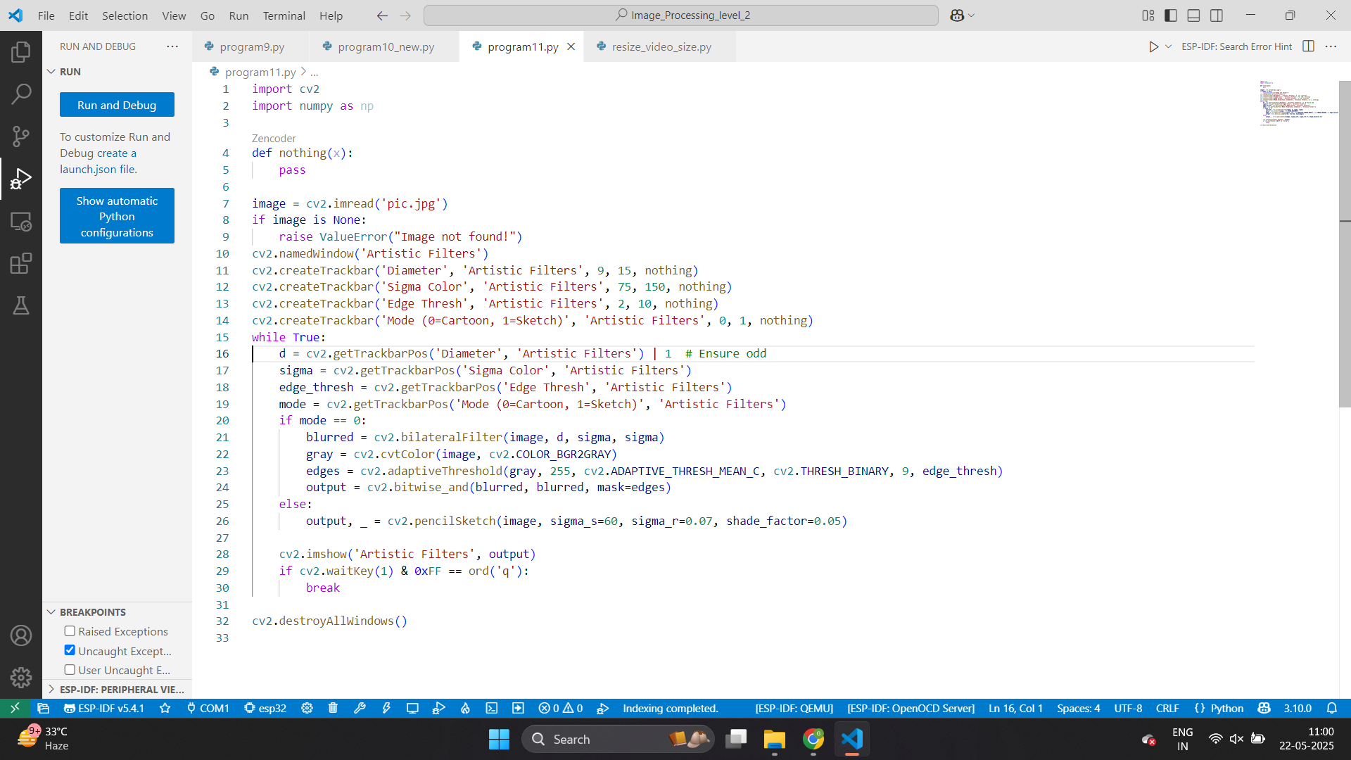

Slide 22
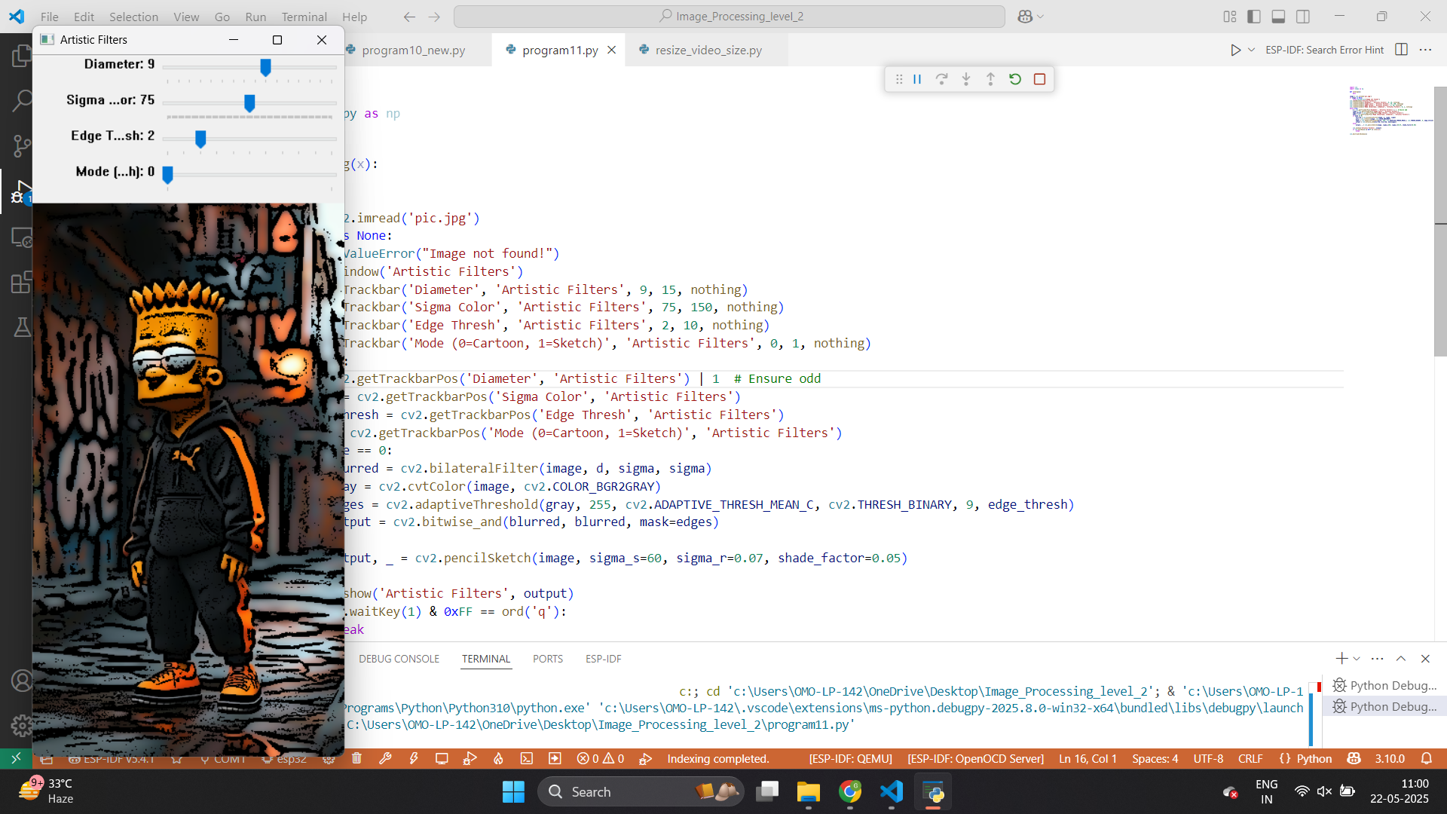

Slide 23


Slide 24
Exercise
1. What is the primary purpose of applying filters for artistic effects in image processing?
A) To compress images for faster loading B) To add creative visual flair to images C) To remove noise from images D) To convert images to grayscale
Answer: B
2. Which OpenCV function is used to smooth colors for the cartoon effect?
A) cv2.GaussianBlur() B) cv2.bilateralFilter() C) cv2.Canny() D) cv2.adaptiveThreshold()
Answer: B

Slide 25
Exercise
3. What OpenCV function is used for edge detection in the cartoon effect pipeline?
A) cv2.pencilSketch() B) cv2.bitwise_and() C) cv2.Canny() D) cv2.divide()
Answer: C
4. Which technique is used to create a pencil sketch effect in the provided code?
A) Bilateral filtering followed by edge detection B) Grayscale inversion combined with Gaussian blur C) Color quantization with Canny edges D) Adaptive thresholding with bitwise operations
Answer: B

Slide 26
Exercise
5. What is the purpose of the cv2.bitwise_and() function in the cartoon effect pipeline?
A) To smooth the image colors B) To combine the smoothed image with the edge mask C) To invert the grayscale image D) To apply Gaussian blur
Answer: B
6. Which OpenCV function provides a fast way to generate a pencil sketch effect?
A) cv2.bilateralFilter() B) cv2.pencilSketch() C) cv2.GaussianBlur() D) cv2.adaptiveThreshold()
Answer: B

Slide 27
Exercise
7. What key is used to exit the real-time filter application loop in the project?
A) Esc B) q C) Enter D) Space
Answer: B
8. Which library is used to compare the original and filtered images side by side?
A) OpenCV B) NumPy C) Matplotlib D) Pillow
Answer: C

Slide 28
Exercise
9. What does adjusting the bilateral filter diameter affect in the artistic effect?
A) The intensity of edge detection B) The smoothness of color regions C) The grayscale inversion strength D) The image resolution
Answer: B
10. Why are artistic filters like cartoon and sketch effects useful in real-world applications?
A) To reduce image file size B) To enhance visual appeal and user engagement C) To improve image resolution D) To remove metadata from images
Answer: B

